Slide 1

Microsoft Excel
LECTURE 7

Slide 2
Nested IF
An IF statement can have two results. The first result is if your comparison is True, the second if your comparison is False.
  =IF(Something is True, then do something, otherwise do something else)
IF statements are incredibly robust, and form the basis of many spreadsheet models, but they are also the root cause of many spreadsheet issues.
Ideally, an IF statement should apply to minimal conditions, such as Male/Female, Yes/No/Maybe, to name a few, but sometimes you might need to evaluate more complex scenarios that require nesting more than 3 IF functions together.
“Nesting” refers to the practice of joining multiple functions together in one formula.

Slide 3
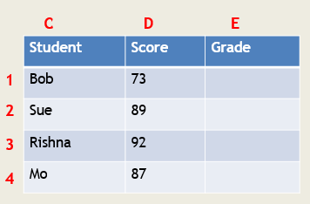
Example – Nested IF
This complex nested IF statement follows a straightforward logic:
If the Test Score is greater than 89, then the student gets an A
If the Test Score is greater than 79, then the student gets a B
If the Test Score is greater than 69, then the student gets a C
If the Test Score is greater than 59, then the student gets a D
Otherwise the student gets an F

Slide 4
While Excel will allow you to nest up to 64 different IF functions, it’s not at all advisable to do so. Why?
Multiple IF statements require a great deal of thought to build correctly.
Incorrect formula will result in wrong answer.
Difficult to update in future.
Notes:
Multiple IF statements require a great deal of thought to build correctly and make sure that their logic can calculate correctly through each condition all the way to the end.
If you don’t nest your formula 100% accurately, then it might work 75% of the time, but return unexpected results 25% of the time. Unfortunately, the odds of you catching the 25% are slim.
Multiple IF statements can become incredibly difficult to maintain, especially when you come back some time later and try to figure out what you, or worse someone else, was trying to do.

Slide 5
COUNTIF function
Use COUNTIF,
  one of the statistical functions,
  to count the number of cells that meet a criterion.
Example: To count the number of times a particular city appears in a customer list.
In its simplest form, COUNTIF says:
  =COUNTIF(Where do you want to look?, What do you want to look for?)

Slide 6
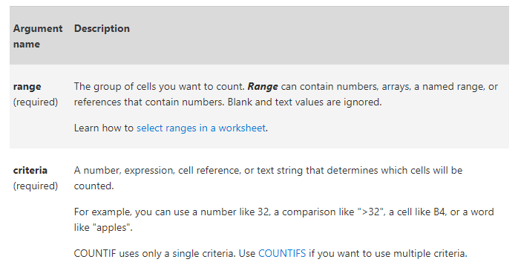
Syntax
COUNTIF(range, criteria)

Slide 7
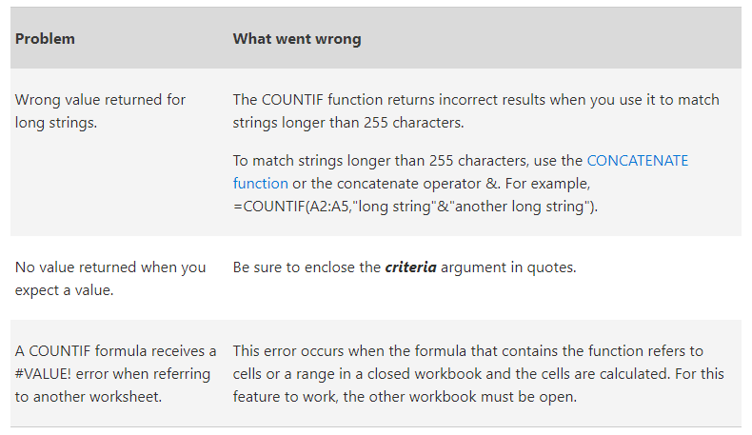
Common Problems

Slide 8
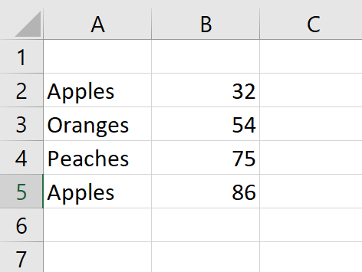
Example – COUNT IF
Design following table in the Excel worksheet as the given format and find the following:

Slide 9
Counts the number of cells with apples in cells A2 through A5.
Counts the number of cells with peaches (the value in A4) in cells A2 through A5.
Counts the number of apples (the value in A2), and oranges (the value in A3) in cells A2 through A5.
Counts the number of cells with a value greater than 55 in cells B2 through B5.
Counts the number of cells with a value not equal to 75 in cells B2 through B5.
Counts the number of cells with a value greater than (>) or equal to (=) 32 and less than (<) or equal to (=) 85 in cells B2 through B5.
Counts the number of cells containing any text in cells A2 through A5. The asterisk (*) is used as the wildcard character to match any character.

Slide 10
SUMIF function
You use the SUMIF function to sum the values in a range that meet criteria that you specify.
For example, suppose that in a column that contains numbers, you want to sum only the values that are larger than 5. You can use the following formula: =SUMIF(B2:B25,">5")

Slide 11
Syntax
SUMIF(range, criteria, [sum_range])
range Required.
  The range of cells that you want evaluated by criteria.
  Cells in each range must be numbers or names, arrays, or references that contain numbers.
  Blank and text values are ignored.
  The selected range may contain dates in standard Excel format.

Slide 12
criteria Required.
  The criteria in the form of a number, expression, a cell reference, text, or a function that defines which cells will be added.
  For example, criteria can be expressed as 32, ">32", B5, "32", "apples", or TODAY().
  IMPORTANT: Any text criteria or any criteria that includes logical or mathematical symbols must be enclosed in double quotation marks ("). If the criteria is numeric, double quotation marks are not required.
sum_range Optional.
  The actual cells to add, if you want to add cells other than those specified in the range argument.
  If the sum_range argument is omitted, Excel adds the cells that are specified in the range argument (the same cells to which the criteria is applied).

Slide 13
Example 1 – SUM IF
Design following table in the Excel worksheet as the given format and find the following:
  Sum of the commissions for property values over 160,000.
  Sum of the property values over 160,000.
  Sum of the commissions for property values equal to 300,000.
  Sum of the commissions for property values greater than the value in C2 ($250,000.00).

Slide 14
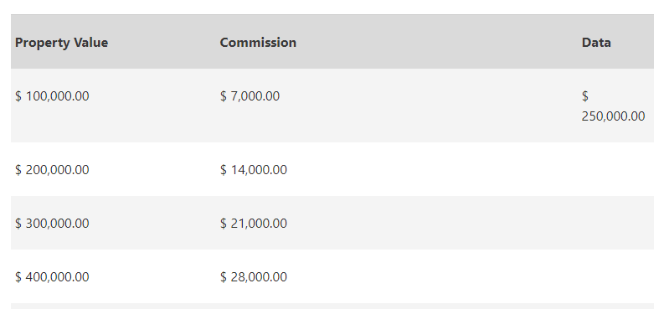
A
B
C
1
2
3
4
5

Slide 15
Example 2 – SUM IF
Design following table in the Excel worksheet as the given format and find the following:
  Sum of the sales of all foods in the "Fruits" category.
  Sum of the sales of all foods in the "Vegetables" category.
  Sum of the sales of all foods that end in "es" (Tomatoes, Oranges, and Apples).
  Sum of the sales of all foods that do not have a category specified.

Slide 16
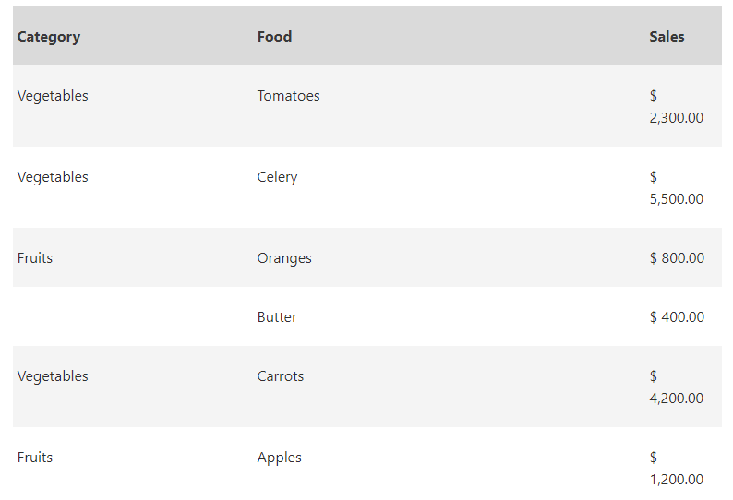
A
B
C
1
2
3
4
5
6
7

